Slide 1

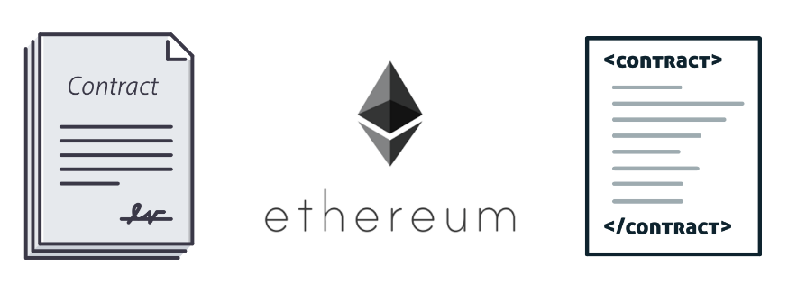

WEEK 3
WEEKLY STATUS REPORT
IoT Blockchain and its applications in Logistics
Mentor: Nguyen Xuan Thong
Reporter: Thanh Tung – Thanh Phuong

Slide 2
CONTENTS
01
SMART CONTRACT
Something about Smart Contract in Ethereum
02
DESCRIBE A BASIC SMART CONTRACT
The process of transact in EVM
03
SMART CONTRACT IN REALITY PROCESS
What happens when make a transact in Smart Contract?
04
DISCUSSION
Consider to choose one most suitable type of Smart Contract

Slide 3

01
SMART CONTRACT
Something about Smart Contract in Ethereum

Slide 4
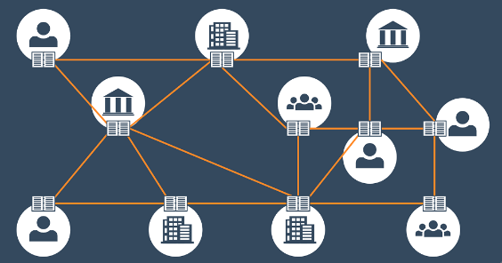

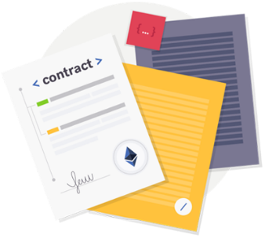
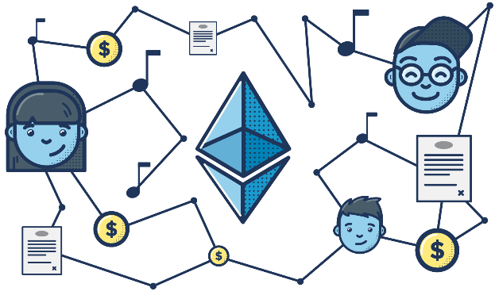
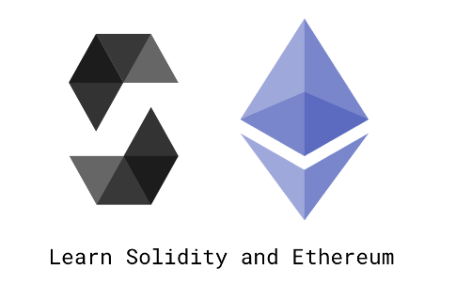
What is Smart Contract?
DISTRIBUTED LEDGER
TYPE OF CONTRACT
A computer protocol intended to digitally facilitate, verify, or enforce the negotiation or performance of a contract.
1994
Nick Szabo
Aa computer scientist, legal scholar and cryptographer
STORED
LANGUAGE AND IDE
Smart Contract is stored on Ethereum Blockchain
Solidity
remix.ethereum.org

Slide 5
Smart Contract in Ethereum
Concept
Image
Operation
Trustworthiness
Free
A set of computer code that run on the top of a blockchain
Like a contract on paper
When these rules are met, these code executes on its own and provides the output.
Anyone can see, but no one can edit.
Ethereum
Geth
Solidity

Slide 6

Smart Contract in Ethereum
Self-enforcing
1
2
Tamper-proof
When these rules are met, these code executes automatically
Since it is built on the blockchain network, the digital contract is also tamper-proof, no can change what’s been programmed.
Automate process
3
4
Reduce paperwork
Due to its self-executing nature, a Smart Contract can help automate processes, deals and transactions
The digital contract can give an end to the confuse and not trustworthy paperwork.

Slide 7
Smart Contract in Ethereum
Supply chain
Health
Care
Application
IoT
PROBLEM
Voting
Support ?
Resource
Cost

Slide 8
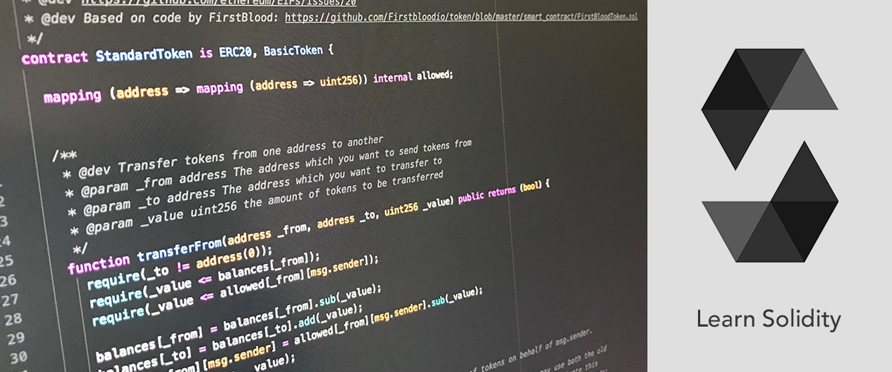
02
DESCRIBE A BASIC SMART CONTRACT
The process of transact in JVM

Slide 9
DESCRIBE A BASIC SMART CONTRACT
Migrate
Deploy your contract to your blockchain:
2
4
1
3
5
Source code
Return
MyContract.sol
Return the result
Complie
Running
If -then
ABI (Application Binary Interface)

Slide 10
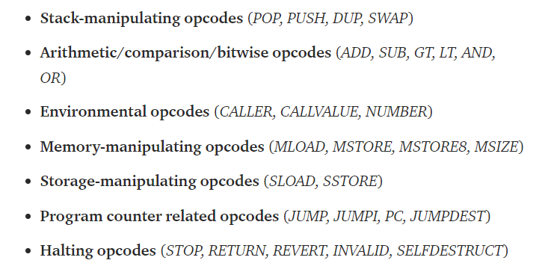
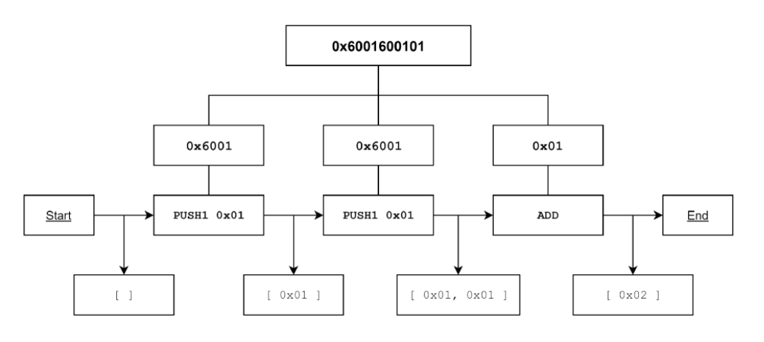
DESCRIBE A BASIC SMART CONTRACT
Complie to opcode
From contract to blockchain
Creating a smart contract
Smart contracts are often written in a programming language called “Solidity”, a language similar to JavaScript and C++
01
02
03
Insert contents
04
Excute
In order to efficiently store opcodes, they are encoded to bytecode. Every opcode is allocated a byte (for example; STOP is 0x00). Let’s take a look at the following bytecode: 0x6001600101

Slide 11
DESCRIBE A BASIC SMART CONTRACT
Decentralized applications
Decentralization
Web3 API
Blockchain
JS application
Call functions
Store smart contract

Slide 12
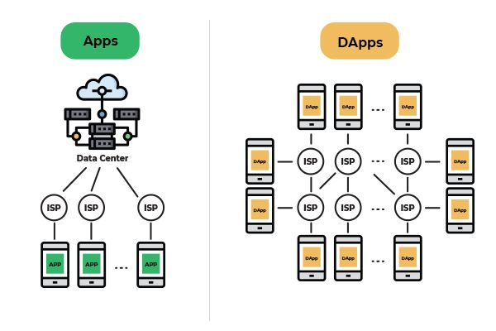

Slide 13
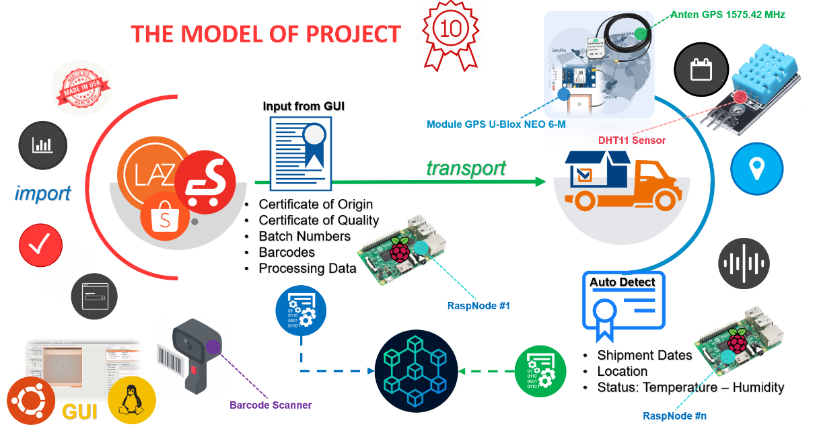
03
SMART CONTRACT IN REALITY PROCESS
What happens when make a transact in Smart Contract?

Slide 14
SMART CONTRACT IN REALITY PROCESS
Structure
Blockchain – smart contract
Execute transaction
Admin
Customer
Address.
Wallet.
InputInfo().
Address.
Wallet.
Order().
Supplier
Transporter
Infomations of goods.
Status.
Type.
Time
Address.
Wallet.
Update().

Slide 15

04
DISCUSSION
Consider to choose one most suitable type of Smart Contract

Slide 16
Discussion
70%
80%
50%
30%

Slide 17
THANK YOU
FOR YOUR LISTENING
延时符

